Slide 1
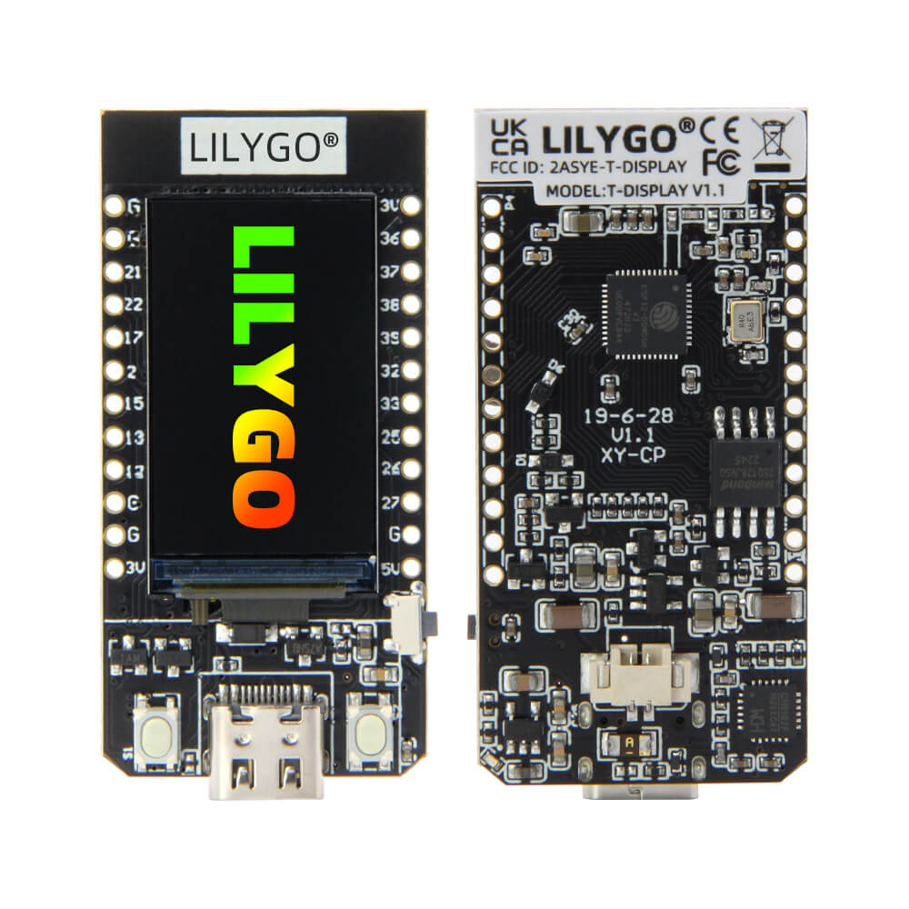







Sensor 1
Sensor 2
Sensor 2
DDNS : harmonis.ddns.net
Docker
Install Node Red, grafana and influxdb

